Slide 1
Reapp
Native Mobile Applications

Slide 2
Cordova
Web front end
Cross-platform
Native api
http://cordova.apache.org/
Notes:
Web based development using HTML, CSS & JS. Develop using web development as we are used to and compile to a native application. Test in chrome debugger. Applications can be compiled native for different platforms such as Android, IOS, Windows Mobile devices. Provides a way to link into the native API through javascript functions using plugins.

Slide 3
Reapp
React UI kit
Packages
Webpack build system
Command line interface
http://reapp.io/
Interactive Animations
Notes:
A set of components for beautiful interfaces on any platform. Optimized for mobile and fully customizable.Packages
Everything you need to build apps from day one, from animations to routing, requests to data management.
Webpack Build System
Spend no time configuring your builds. Hot reloads and ES6 out of the box with Webpack and Babel.
Command Line Interface
Create new apps, serve them, build them to Cordova or the web with one command.

Slide 4
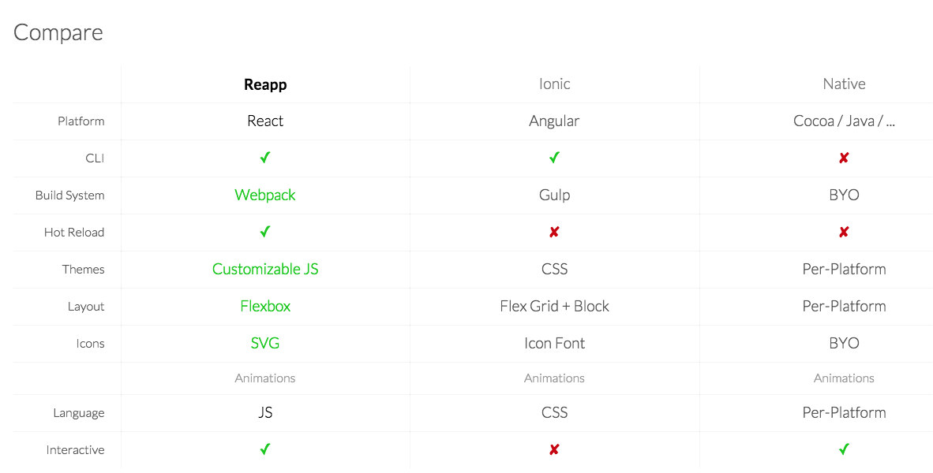

Notes:
Interactive animations

Slide 5
Other Frameworks
Ionic (Cordova Angular, Angular 2.0) http://blog.ionic.io/angular-2-ionic/
TouchstoneJS (Cordova ReactJS) https://github.com/touchstonejs/touchstonejs
React Native (not Cordova) http://www.reactnative.com/introducing-react-native/
Meteor (like Cordova, Angular/React) https://github.com/meteor/meteor

Slide 6
Examples
https://github.com/rlloyd2001/reapp-presentation
https://github.com/reapp/kitchen-sink

